Slide 1
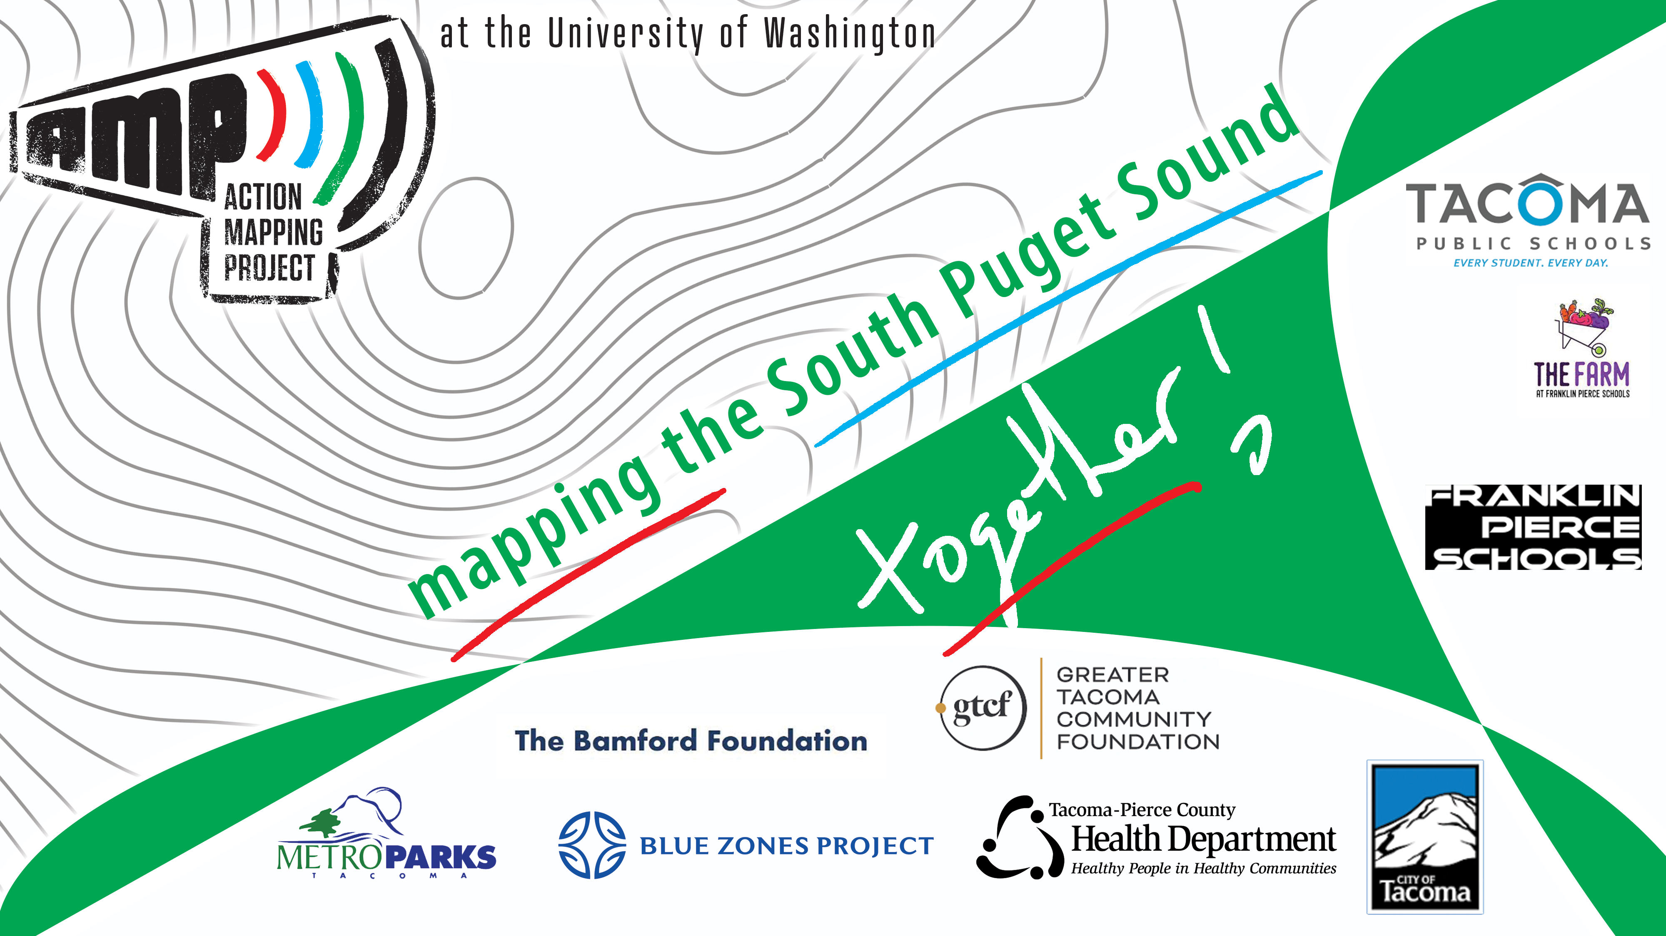
Notes:
Hello! I’m __________ .
I’m from the UW Tacoma. Where I work for the Action Mapping Project, or AMP.
AMP has been working with schools in Tacoma’s communities for the past 10 years, and our goal is to help our decision-makers better understand kids’ experiences around the city.
And why do they want to know about your experiences? Because their job is to make sure that people who live in this city are living their best lives.
Knowing that, for instance, a particular park is gross and unpleasant to spend time in helps our parks folks to make good decisions about how to improve places like that.
So, along with Metro Parks Tacoma, some of our other partners include the Health Department, City of Tacoma, and even some of our local philanthropic organizations. The best part is that they are excited to hear from you.
And that’s why I’m here today! Because we’re going to spend the next 45 minutes or so imagining the small changes in your neighborhoods that can have a huge impact on your personal everyday life.
That’s really cool. Before we get there, though, we’re going to think about…

Slide 2
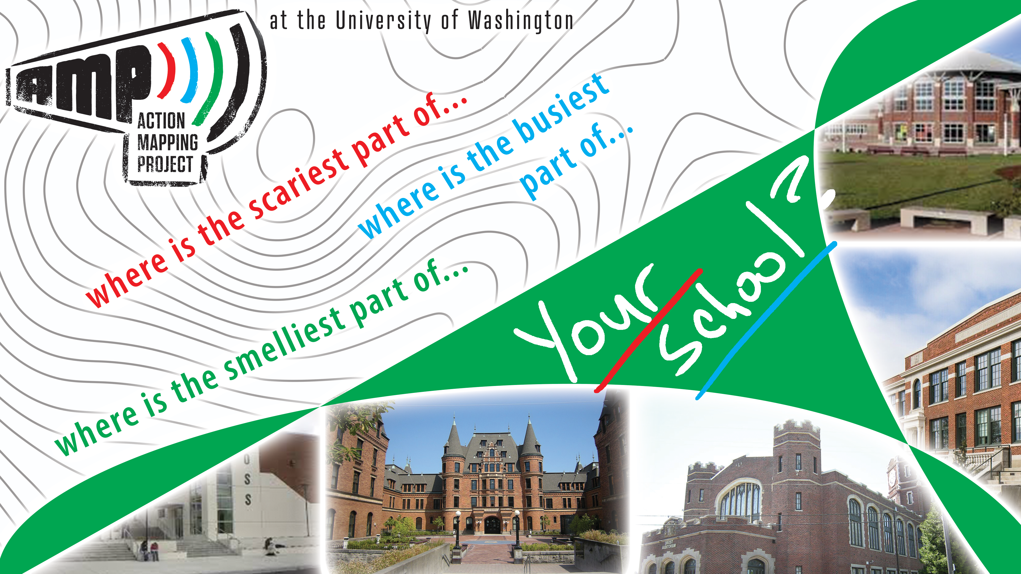
Notes:
Your School!
Because it’s the place you’re probably very familiar with right now.
We’re just going to talk for a few minutes about how you perceive and experience your school.
Let’s start by thinking about smelly stuff. I’m sure you’ve experienced it.
That one corner, maybe it’s a whole room, maybe it’s the whole school – but there’s something smelly about it.
Where is that location at your school? Is it a trashcan in the back room? Maybe it’s the gymnasium drain hole? Think about your smelly place – where is it, exactly? If you were to draw it on a map?
***Now they share***
OK, now we’ll get a little more serious.
Let’s talk about either being scared or being annoyed. Annoyed, in this case, by crowds.
So, think again about your school. Where do you feel a little be scared when, maybe, it’s dark outside or you’re alone.
And while you’re at it, think also about those areas in your school that get really busy.
***Now they share***

Slide 3
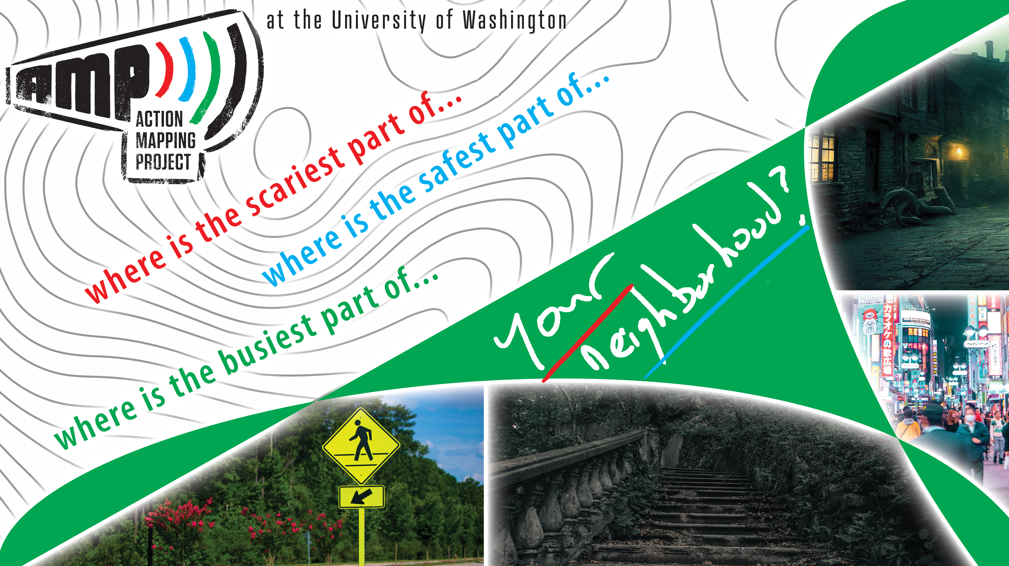
Notes:
Let’s talk now about outdoor spaces – your neighborhood!
Similar questions, but now we’re talking about shared public spaces. I bet that if we asked a handful of kids from the same neighborhood where they felt most unsafe, they’d almost all say the same thing.
That’s because we tend to share experiences with each other when we’re in the same places.
So, thinking about your neighborhood – where do you imagine that younger kids feel a little scared or unsafe?
***let them talk now***
Now, the flip side of that question is – where do you think that younger kids, or even yourselves, feel most safe in your neighborhood? And don’t just say ‘my house’. Be a little more creative than that.
***let them talk now***
Great job! Last question, and it’s pretty easy – where is the busiest part of your neighborhood? Most traffic? Most people? Share a few spots that come to mind.
***let them talk now***
As you’re seeing, our experiences are really similar. The problem is that when we have money to spend to improve our communities, it’s not always clear where there are opportunities to do that.

Slide 4
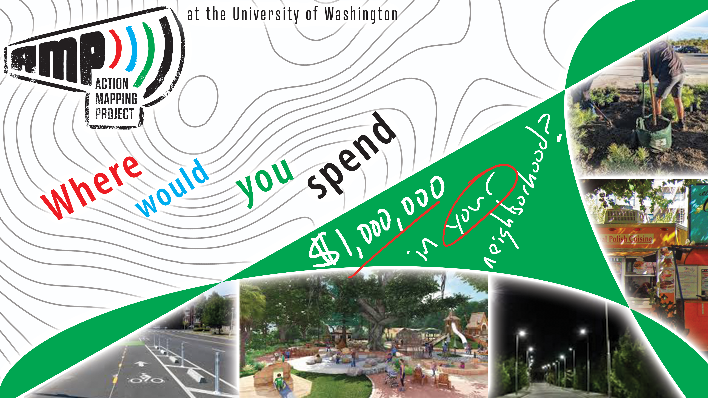
Notes:
And that’s, in a lot of ways, what we’re doing today.
We’re working together to tell our stories so that the folks who have the power and the resources to improve our neighborhoods know where to spend the money.
In Tacoma, for instance, there is a program that is spending 1,000,000 dollars in five regions of the city.
The challenge for them is to know where this money will have the greatest impact.

Slide 5
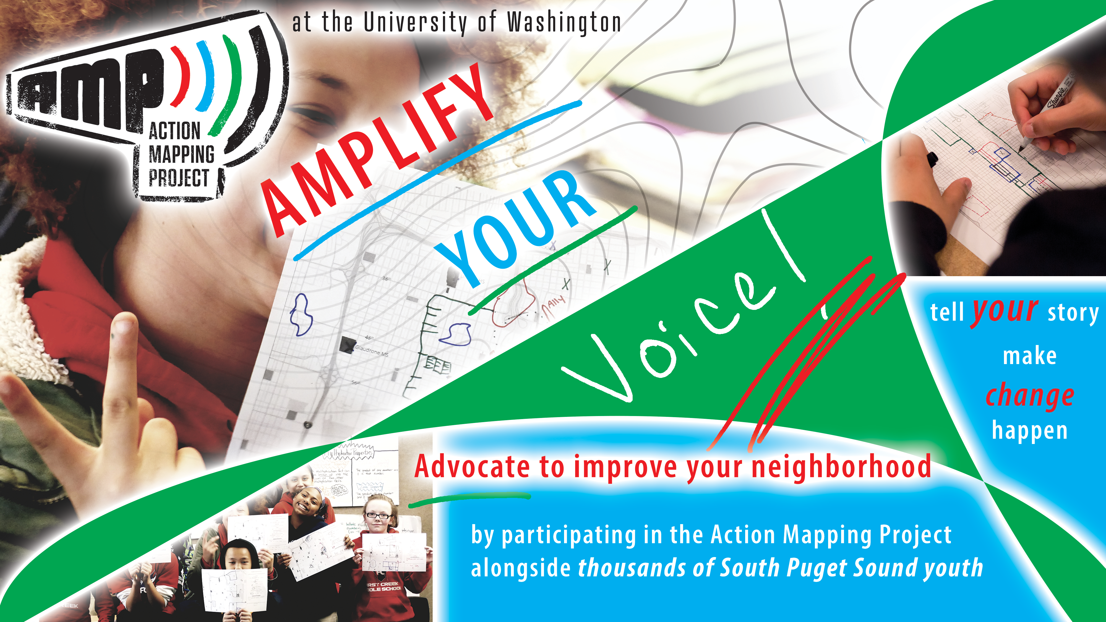
Notes:
This is something that you can help with today!
Our goal is that you have an opportunity to tell your story.
So do it!
Draw your maps, share your experiences, and when your friends do the same we’ll start to see similarities. Those are our opportunities.
The parks that everyone things are gross, or the crosswalks that are super dangerous – these are your shared experiences, and they’re incredibly valuable to decision makers.

Slide 6
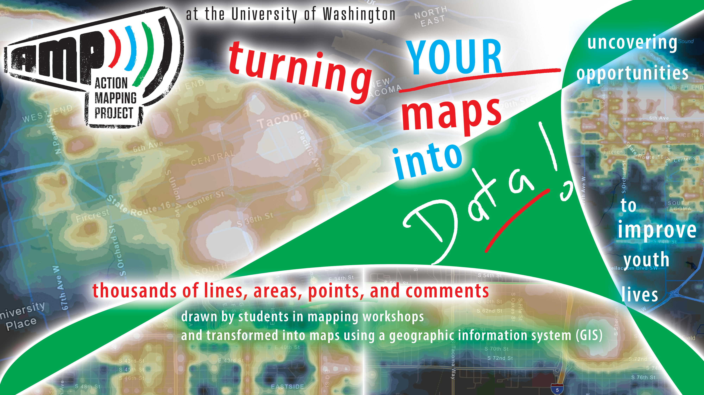
Notes:
OK, now you’re thinking…what exactly are we doing today?
Well, to do the work that we do at AMP, we run workshops like this at middle schools and high schools. In these workshops we start by responding to a few questions and prompts, and then we spend a lot of time drawing on maps.
It’s really fun, and the drawings that you share are transformed into maps like you see on this slide.
The map on the top left, for instance, represents places in Tacoma where people tend to spend time, and on the top right you’re looking at a map that represents popular walking and biking routes.
We create these maps using geographic information systems – or GIS, for short. With a GIS we can make maps, analyze data, and tell complex stories in ways that are easy to understand.

Slide 7
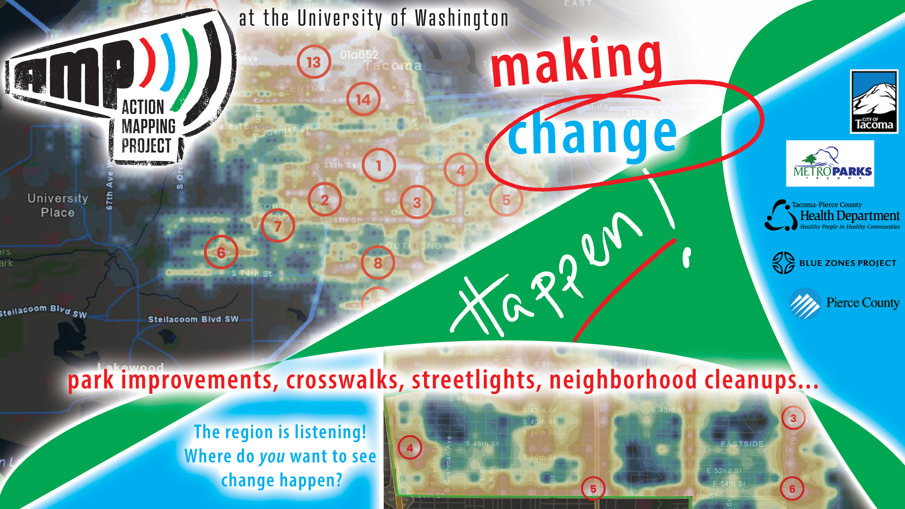
Notes:
And from those maps, we are illuminating the best opportunities for local agencies to invest in our neighborhoods.
From park improvements to better and safer crosswalks, the stories that you share today will influence where money is spent in the region.
Because our partners are listening!
And they want, more than anything else, to ensure that our neighborhoods are places where youth feel safe, happy, and at home.

Slide 8
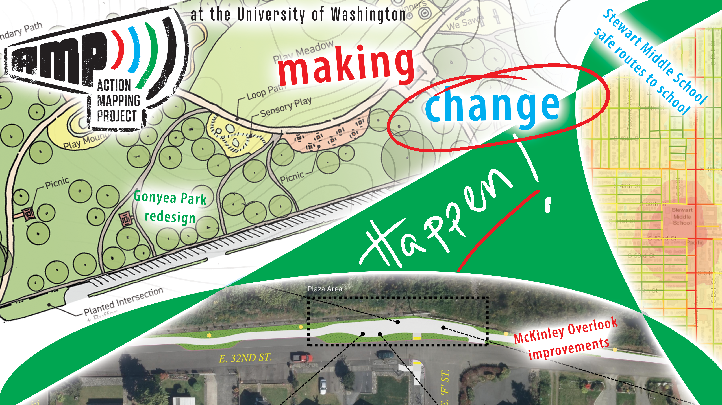
Notes:
This means reflecting on what our youth have shared, and then conducting projects like the Gonyea Park redesign in Parkland, or the improvements that are being made to the McKinley Overlook in Tacoma, or the Safe Routes to Schools work around Stewart Middle School.
In all of these cases, we’ve worked closely with youth just like yourselves to share opportunities within neighborhoods with the agencies that have the resources to make change happen.

Slide 9

Notes:
So here we are, today in your ---SUBJECT--- Class. And maybe you’re thinking to yourself, hey, this is interesting but a little unrelated to what we normally do in class.
The reality is, though, that maybe the coolest part of this project is that no matter your area of expertise, we’re likely doing something related to it!
In this class, for instance…
Social Science (history/geography)
You might be thinking about how societies develop, invent, and change over time. Maybe also how they make decisions and how they planned. With the work we’re doing today, you are participating in both the planning and development of our region. The folks that are listening are elected officials, representatives of local governments, and the advocates that work to make our lives better.
Societies change, develop, and grow in response to the needs of the people – that’s the essence of democracy, and it’s a core aspect of what we are doing today.
Math
You’re likely learning (or will learn) about recognizing patterns in numbers, and that’s what we are doing with AMP data. We are recognizing where things are similar and where things are different by comparing numbers, or groups of numbers, which we call data.
You are probably also learning about averages and medians and modes - and that’s what we are doing with AMP data. We are using averages and comparing those to understand where we have small differences and where we have big differences. It’s all math!
Technology
You’re probably learning about how technology develops and changes over time and how innovation is always pushing things further. This project grew out of a need to take information and put it on a map and say something about the patterns that emerge. It grew from several smaller pieces of tech and now stitches them all together!
And we are using a Geographic Information System, or a GIS, to turn your stories into maps and data.
Health
You are probably learning a lot about how we need to move our bodies in order to be healthy. You need access to parks and you need to want to go to those parks! So if we can help understand how to improve parks to get more kids to parks, we are making our communities healthier.
Now, before we get into our mapping activities, there’s one last slide to share with you.

Slide 10

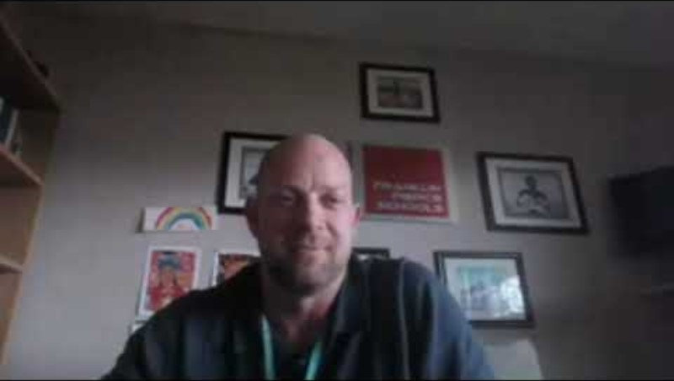
Notes:
After the video…
As you can see, your voice truly does matter to the folks who make decisions in our region.

Slide 11

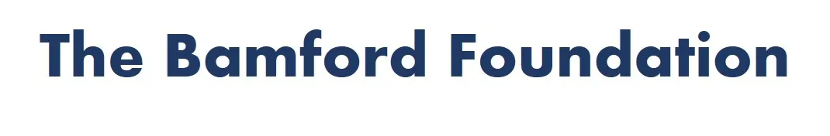





Notes:
Quotes from city or parks people encouraging participation. (videos)
After the videos…
As you can see, your voice truly does matter to the folks who make decisions in our region. And we’re going to spend the next 45 minutes or so thinking a lot about how small changes in your neighborhoods can have a huge impact on your personal everyday life. That’s really cool.
Project partners and agencies involved:
Tacoma Pierce County Health Department (using AMP data for active transportation (getting kids outdoors), food access after school (where do kids feel safe) traffic safety and walkability, firearm violence prevention, )
Pierce County Parks (using AMP data for park investment in Parkland, like Gonyea Park)
Pierce County Planning and Public Works (using AMP data for Vision Zero (reduce traffic fatalities)
Bamford and GTCF are community funds that invest in our neighborhoods by funding projects like the Action Mapping Project that have a direct benefit to our region.
Before we get there, though, we’re going to think about…

Slide 12
Let’s start mapping!
www.ActionMappingProject.com
Notes:
Thanks Mayor Woodards!
On that note, let’s begin!
Please take out your laptop and navigate to www.ActionMappingProject.com. The link to the mapping platform is at the bottom of the screen. Or, perhaps, your teacher has shared a link with you.
Either way, it’s time to get to mapping!

